Slide 1


Razpis msca postdoctoral fellowships 2024
Stojan Sorčan
17. november 2023
UNIVERZA V MARIBORU

Slide 2
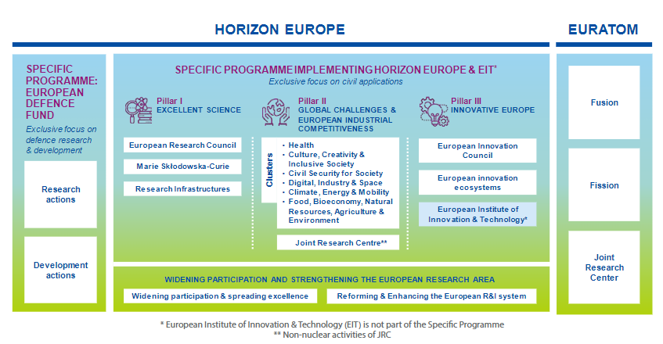
HORIZON EUROPE
Main goals of the programme:
Maximise its impact and deliver on the EU’s strategic priorities, such as the recovery, green and digital transitions, and tackles global challenges to improve the quality of our daily lives.
Enhance access to excellence for researchers across Europe to foster participation and collaboration.
Foster the EU’s industrial competiveness and its innovation performance, notably supporting market-creating innovation via the European Innovation Council and the European Institute of Innovation and Technology.
Strengthen EU science and technology by increasing investment in highly skilled people and cutting-edge research
Horizon Europe will have a budget of around €95.5 billion for 2021-2027 (current prices).

Slide 3


Marie Skłodowska-Curie actions
Erasmus +
Marie Skłodowska – Curie actions
European Research Council - ERC
Potential career development of researchers in all career stages
(from students to participating in excellent science (MSCA) and ground breaking science (ERC)
Postdocs
Experienced researchers
Doctoral students
Young postdocs
Students
Doctoral students
EU’s reference programme for doctoral and postdoctoral training, contributing to:
A highly skilled research-based human capital able to detect and tackle upcoming challenges, communicate scientific evidence to policy-makers and the public, and work across disciplines
Provide researchers with skills needed in the labour market, to innovate and to convert knowledge and ideas into products and services for economic and social benefit
Develop excellent doctoral programmes enhancing the global attractiveness and visibility of institutions involved in them
Promote the EU’s global attractiveness for talents

Slide 4






Introduction to MSCA: Key features
Researchers’ training, skills and career development (all stages of career)
Attractive working and employment conditions
Structuring impact on organisations through excellent programmes
Excellent research in all domains (bottom-up approach)
International, cross-sectoral & interdisciplinary mobility
Strong collaboration with industry and SMEs
MSCA budget under Horizon Europe: 6,6B€
Excellent Science (Pillar 1): reinforcing and extending the excellence of the EU’s science base
Worldwide geographic coverage

Slide 5





Postdoctoral Fellowship
COFUND
Doctoral Networks
Staff Exchanges

Slide 6
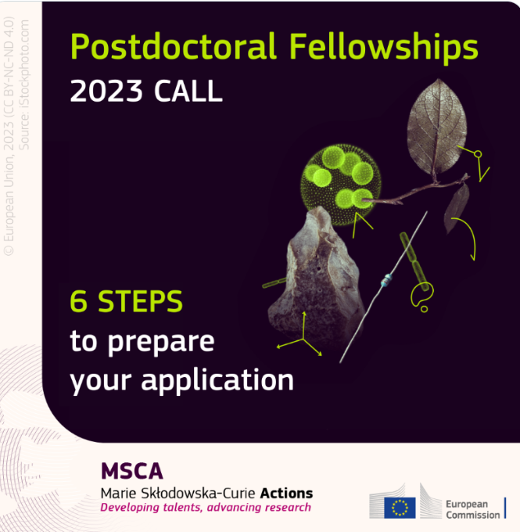
Next Postdoctoral Fellowships call opening soon: 6 steps to prepare your application | Marie Skłodowska-Curie Actions (europa.eu)

Slide 7



Slide 8
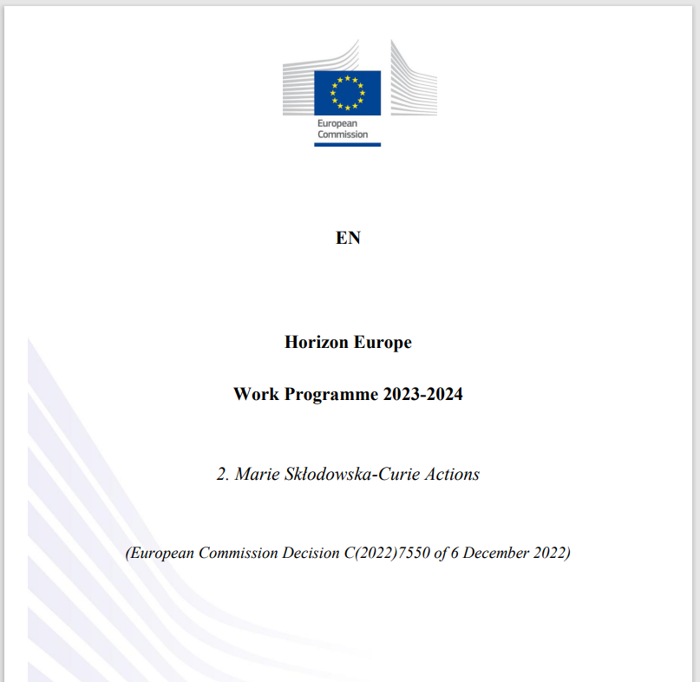
1,8 mrd EUR

Slide 9
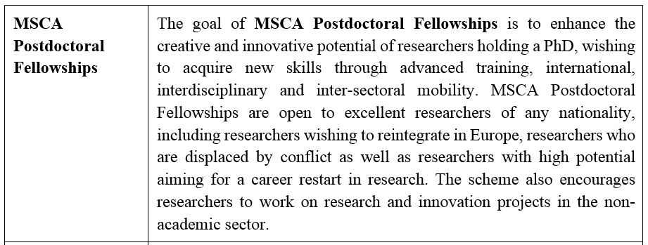

Slide 10

DECODING THE WORK PROGRAMME
What objectives, outcome and impact project should achieve
The scope provides applicants with expected project objectives that need to be included in a proposal.
The scope provides information on:
what type of challenges the project should be addresssing,
what should be the project‘s purpose
and also identifies other aspects that must be considerd when writting the proposal (policy context, gender dimension, open science, responsible research and innovation, EU competition, EU green deal…)
Frame your idea within the Work programme!

Slide 11
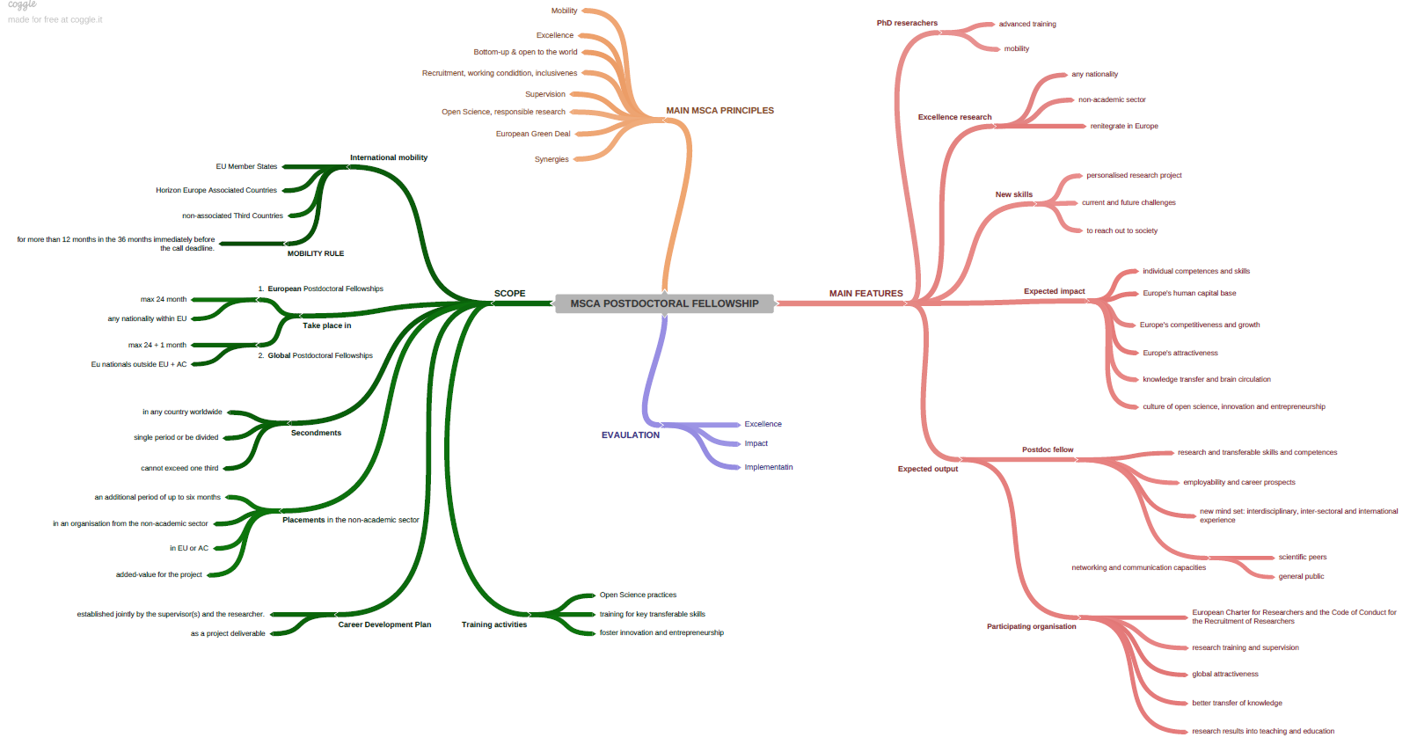

Slide 12
Izvedba podoktorskega raziskovalno-izobraževalnega projekta
Znanje in veščine
Vpliv na posameznika in raziskovalno organizacijo
New mind-sets: 3I
Mreženje
2023: 12.4. – 13.9; 260,5 mio EUR
2024: 10.4. – 11.9.; 270,8 mio EUR
Charter&Code
Odličnost
Reintegracija v EU
EU/global konkurenčnost
KRITERIJI
RAZPIS
NAMEN
Učinek
Secondment: do 1/3 časa
Evropska štipendija
(do 2 leti)
Izvedba
OBLIKA
Posameznik
(5.080/ccc + 600 + 660 za družino)
Globalna štipendija v TC (do 3 leta)
FINANCIRANJE
Postdoctoral Fellowship
Placement v ne-akademskem sektorju do 6 mesecev po zaključku
Organizacija
(1.000 + 650)
Podoktorski raziskovalec
Max 8 let raziskovalnih izkušenj + izjeme
Raziskovalna organizacija
Prijavitelj: akademska ali ne-akademska organizacija
Raziskovalec
POGOJI
Mobilnostno pravilo
Zaposlitev in mentoriranje
Gostujoča institucija: članica EU ali pridružena HE
Reintegracija: v TC ali 12 mesecev v EU
Katerekoli nacionalnosti

Slide 13

Rules in a nutshell
• Project by an individual researcher
• max. 8 of research experience from date of award of the (first) doctoral degree
• Mobility rule: The researcher cannot have resided or carried out his/her main activity (work, studies, etc.) in the country of the beneficiary for more than 12months in the last three years prior to the call deadline
• located in EU member state
or Horizon Europe associated country
• Public or private research organisation, university, research centre, international European interest organisation, international organisation, industry, SMEs
(any sector)
researcher +
host organisation

Slide 14
Rules in a nutshell
Project realized at a host institution located in EU MS or AC
Researcher of any nationality
Duration: 12-24 months
Large part of the project realized at a non-European institution
Researcher needs to be a national or long-term resident of a EU MS or AC
Duration: 24-36 months
12-24 months out of Europe
+ 12 months mandatory reintegration phase in a EU MS or AC
European fellowship Global fellowship:

Slide 15
Compile your fellowship: facultative elements
 | Secondment | Non-Academic Placement
Maximum Duration | European Postdoctoral Fellowships: Up to 1/3 of the normal project duration. Global Postdoctoral Fellowships: Optional secondments are permitted for up to 1/3 of the outgoing phase. | Up to 6 months duration.
Timing | European Postdoctoral Fellowships: At any time during the standard project duration. Global Postdoctoral Fellowships: Optional secondments cannot take place during the mandatory 12 month return period to the host organisation in a MS or AC. They may take place at the start of the outgoing phase (up to three months, to be included within the 1/3 maximum duration). Note that all optional secondments can be divided into several shorter periods. | Additional period after the standard duration of the fellowship.
Mobility | Any country worldwide | MS or AC
Sector | Any sector | Non-academic sector only

Slide 16
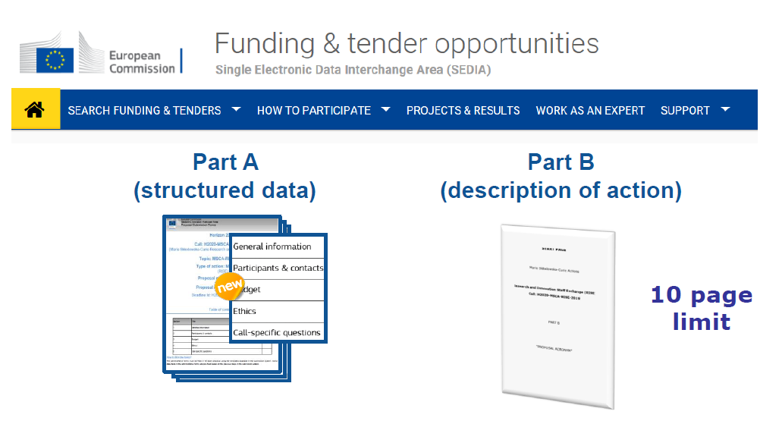
Proposal structure

Slide 17





Proposal structure
Part A – administrative forms
are filled on-line Funding&Tenders
Part B1 – the proposal (max 10 pages PDF uploaded)
#Excellence
#Impact
#Implementation, incl. Gantt Chart
Part B2 – no page limit, PDF uploaded
#CV of the Researcher
#Capacities of the Participating Organisations
#Letter of Commitment of Partner Organisations → GF
#Ethical aspects

Slide 18
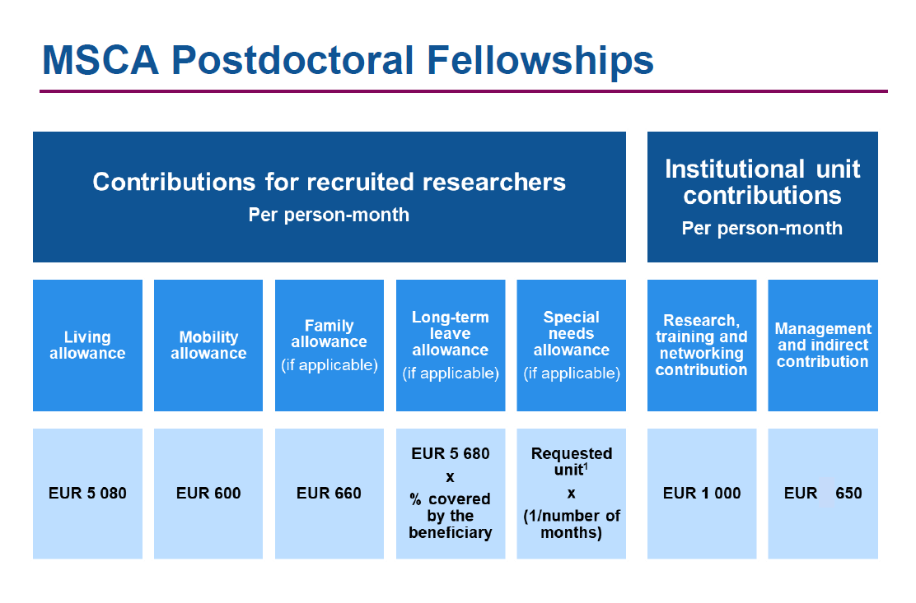
A country correction coefficient applies to the living allowance in order to ensure equal treatment and purchasing power parity for all researchers. Slo = 83,3%

Slide 19
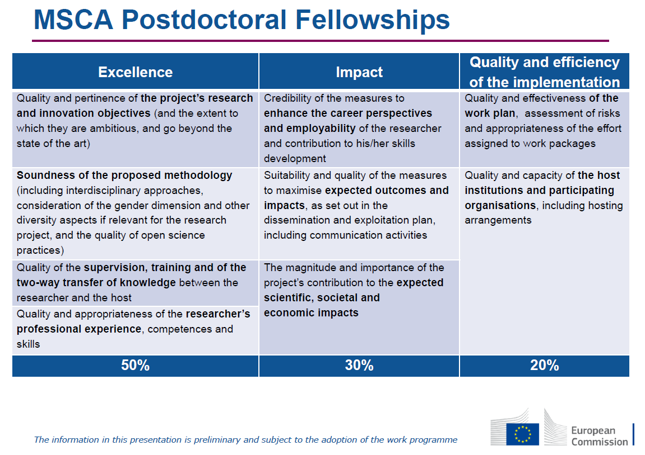

Slide 20
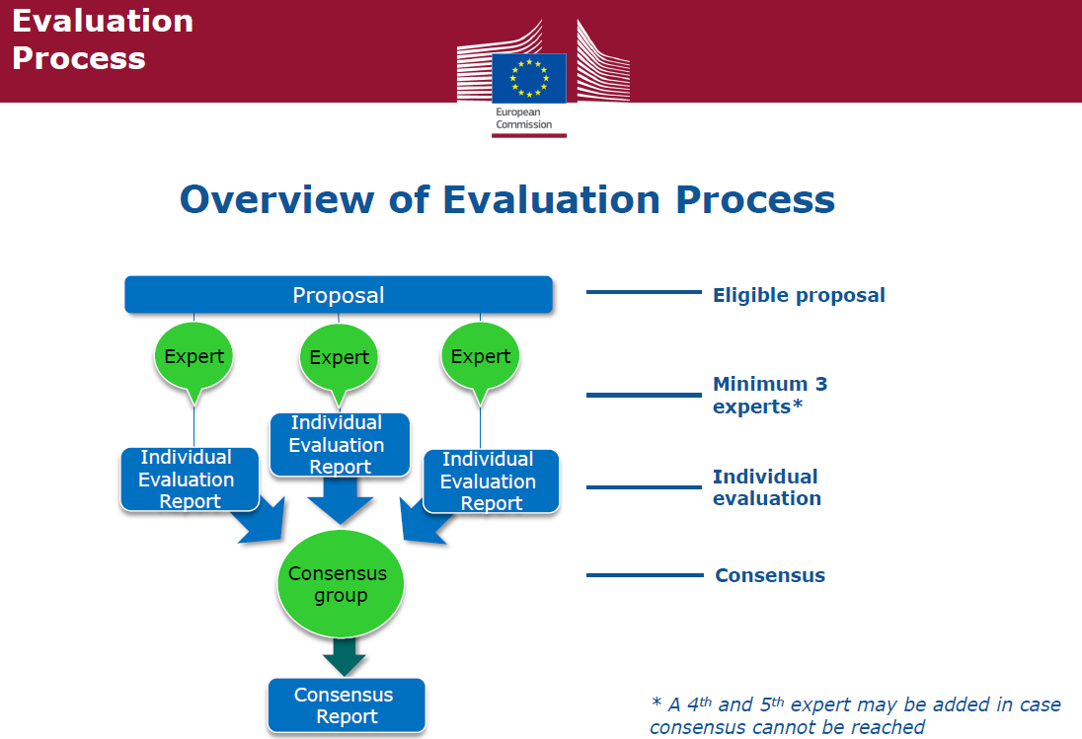

Slide 21
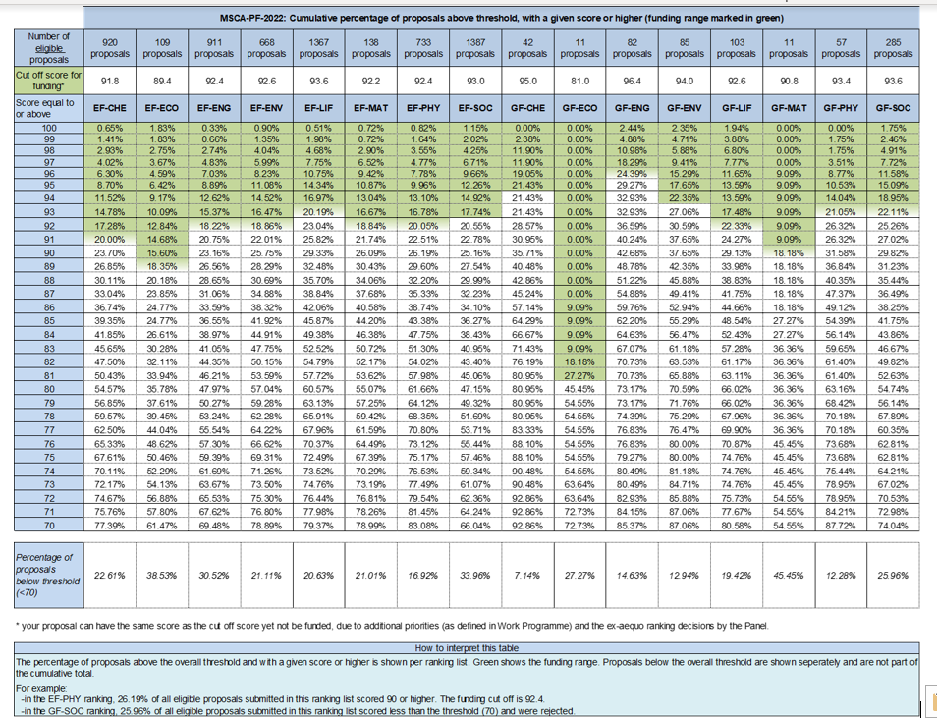
MSCA PF
ERA FELLOWSHIP
Seal of Excellence
Razpis ARIS – NOO

Slide 22
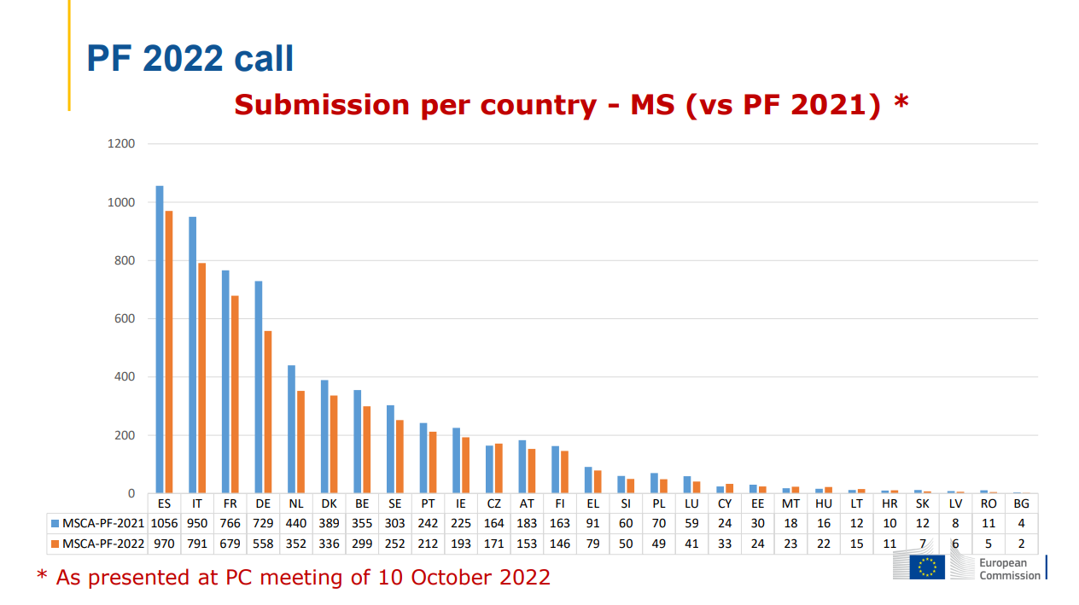

Slide 23
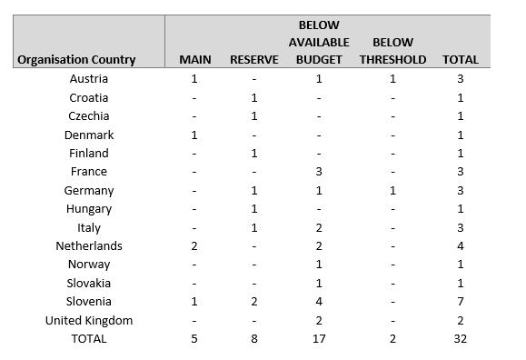
Slovenski prijavitelji na gostiteljskih organizacijah v tujini na razpisu MSCA PF 2022

Slide 24
Evalvacijske ocene slovenskih raziskovalnih organizacij na razpis MSCA PF 22 po panelih

Slide 25
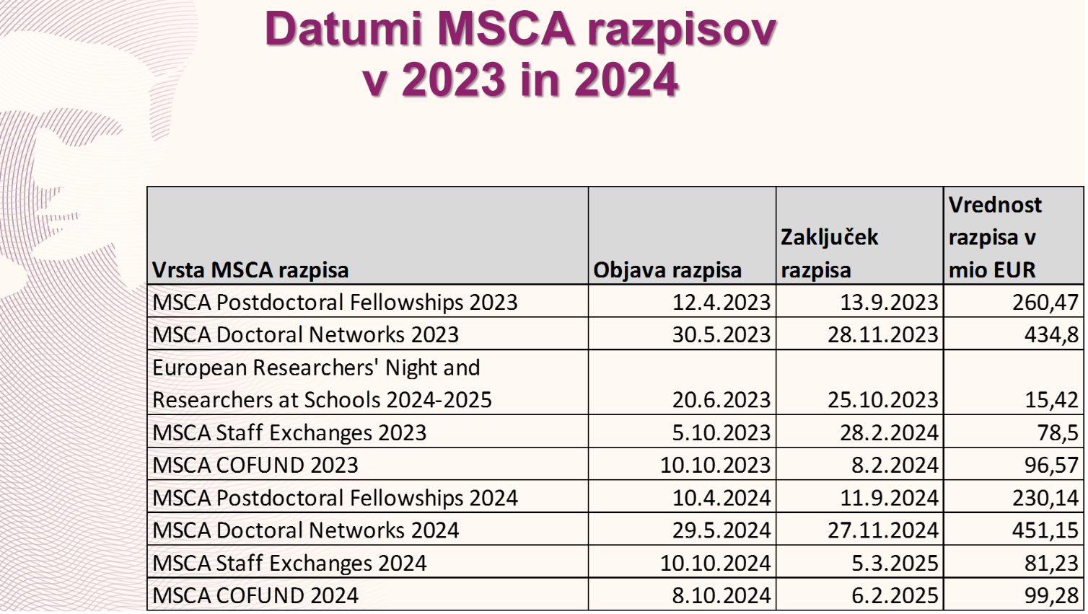
270,8

Slide 26

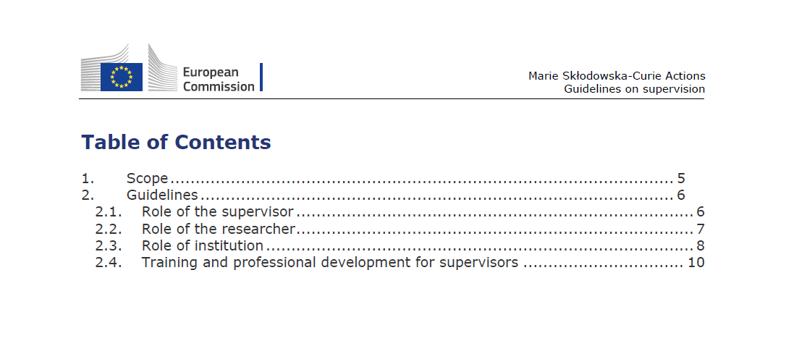

Slide 27
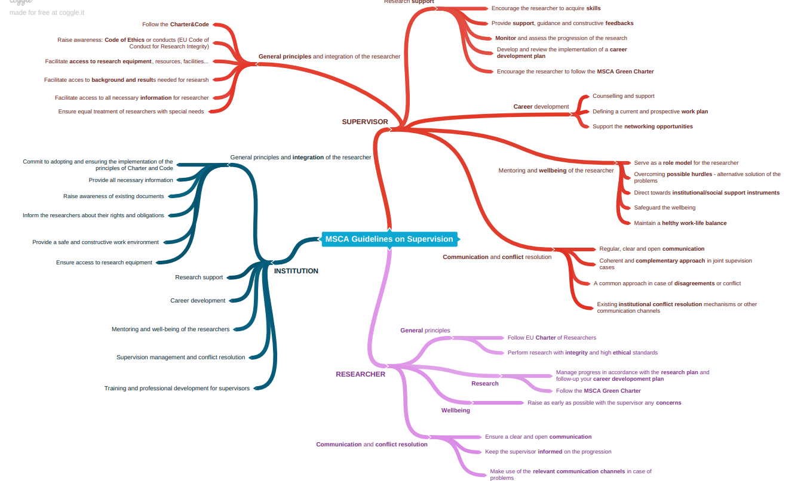

Slide 28
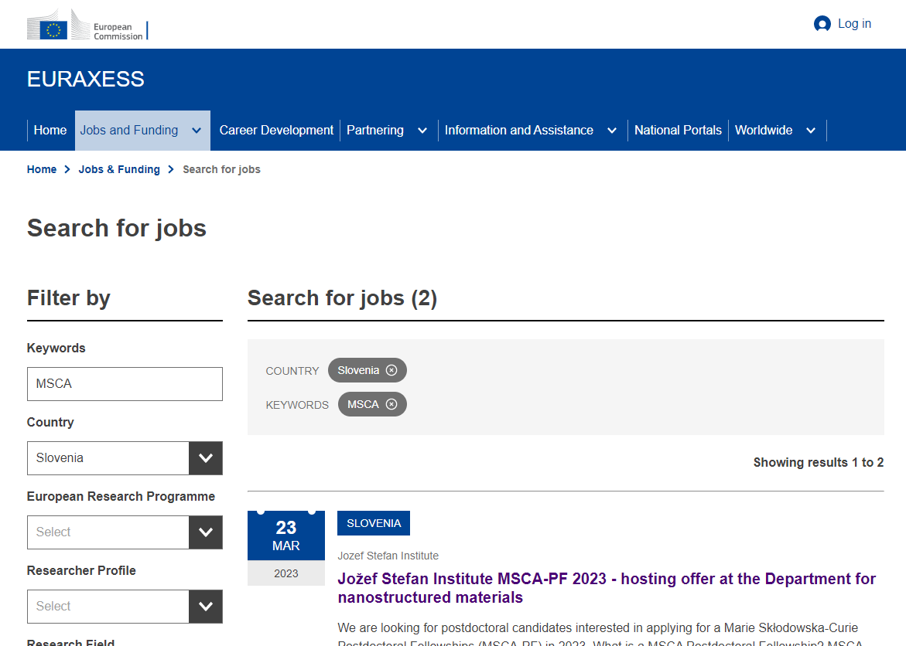

Slide 29
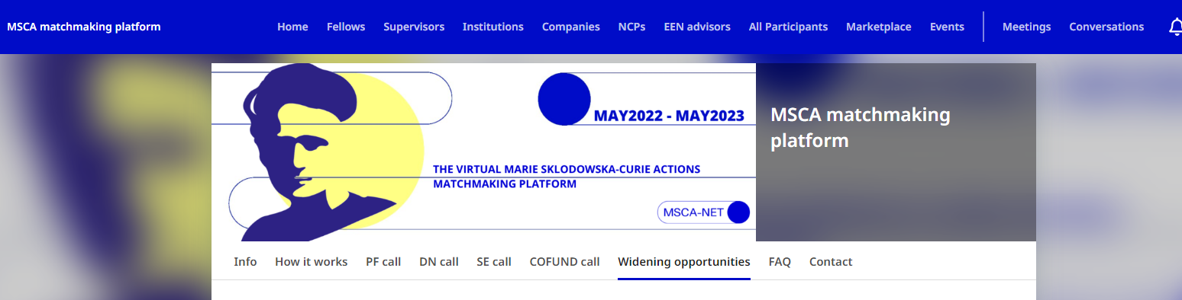

Slide 30
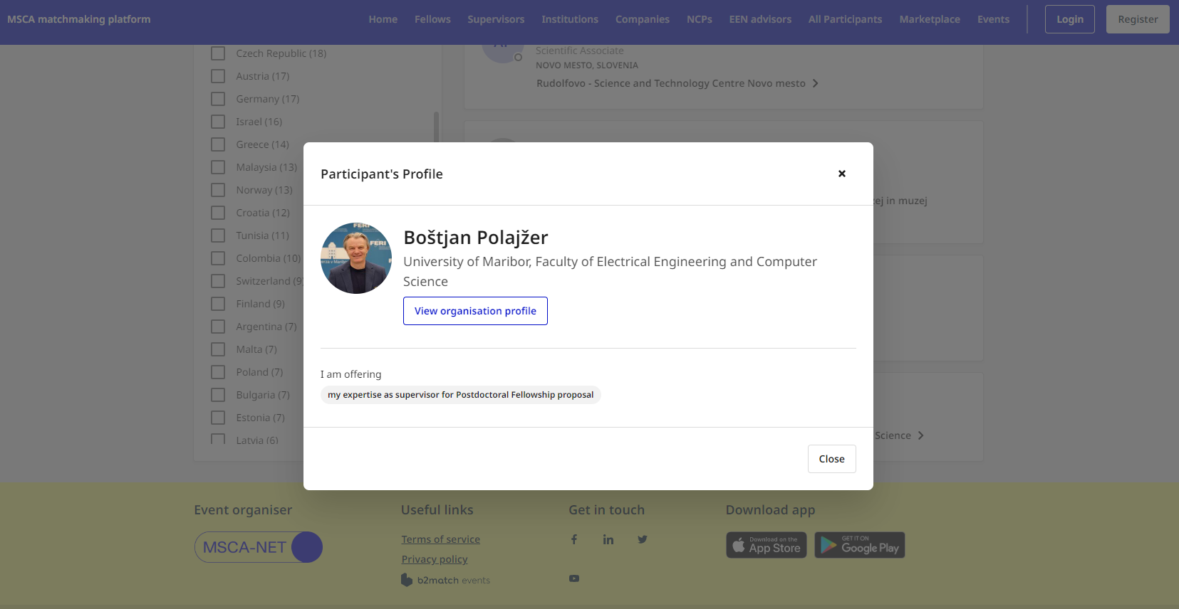

Slide 31







Key principles
Your proposed work must be within the scope of a work programme topic
You need to demonstrate that your idea is ambitious and goes beyond the state of the art
Your scientific methodology must take into account interdisciplinary, gender dimension and open science practices. It must not significantly harm the environment
You should show how your project could contribute to the outcomes and impacts described in the work programme (the pathway to impact)
You should describe the planned measures to maximise the impact of your project (‘plan for the dissemination and exploitation including communication activities’)
You should demonstrate the quality of your work plan, resources and participants

Slide 32

Useful documents
Official documents:
Guide for Applicants
MSCA Work programme 2023-2024
Funding & Tender Opportunities Portal – Online manual
MSCA Guidelines on supervision
MSCA Green Charter
Unofficial documents:
MSCA-NET Handbook
+ materials from trainings by your NCP or the project office of your host organisation

Slide 33
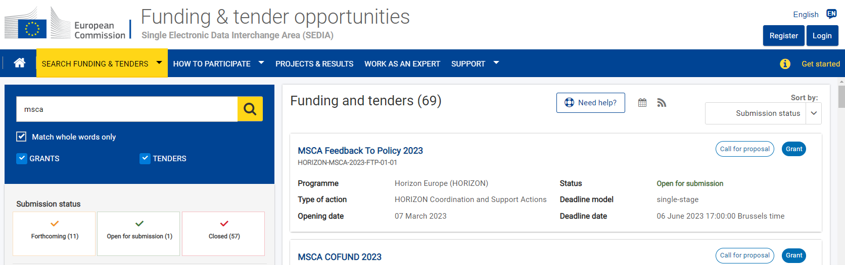

Slide 34
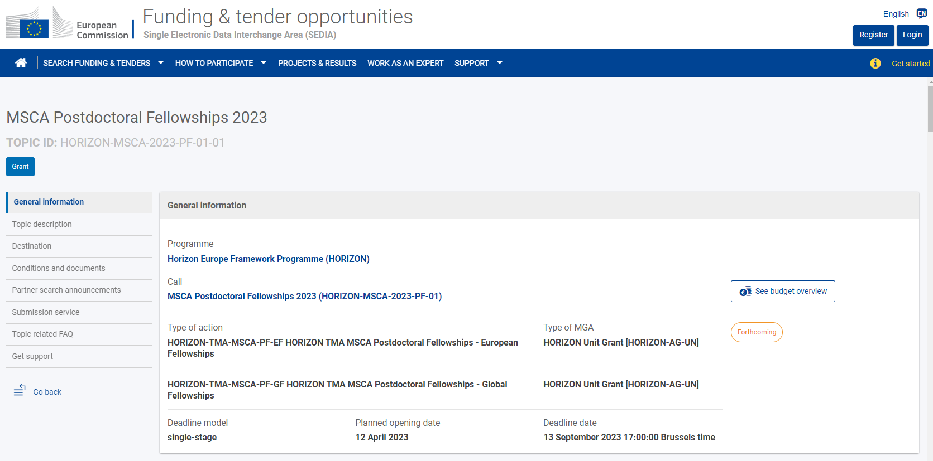

Slide 35
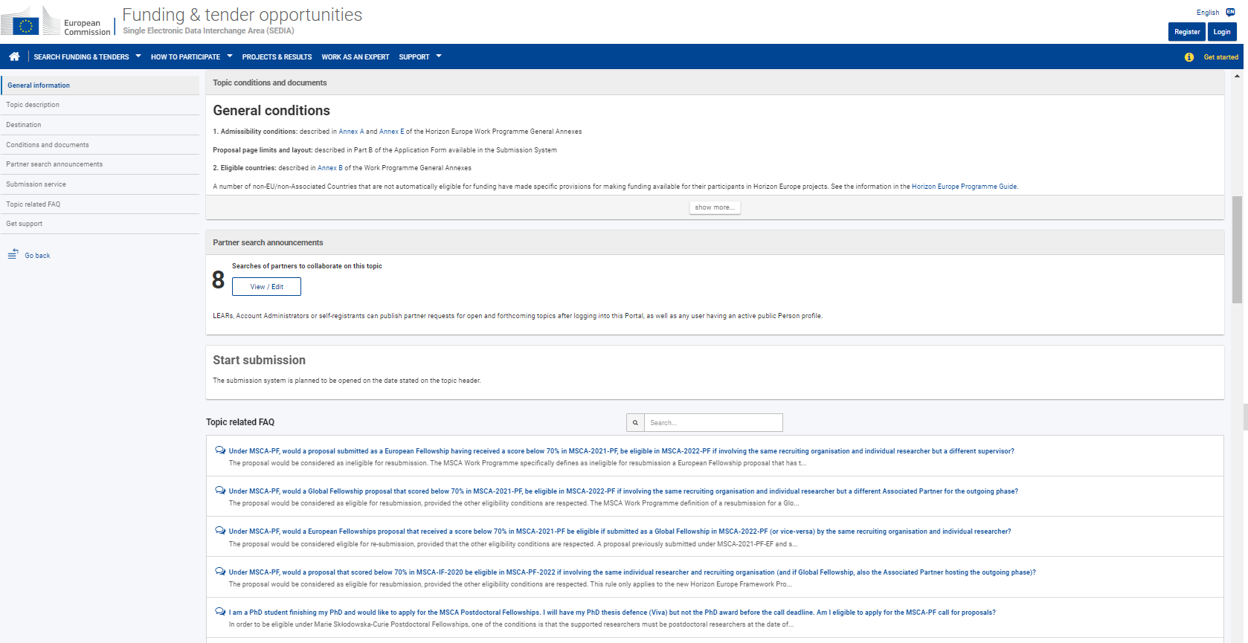

Slide 36


Slide 37
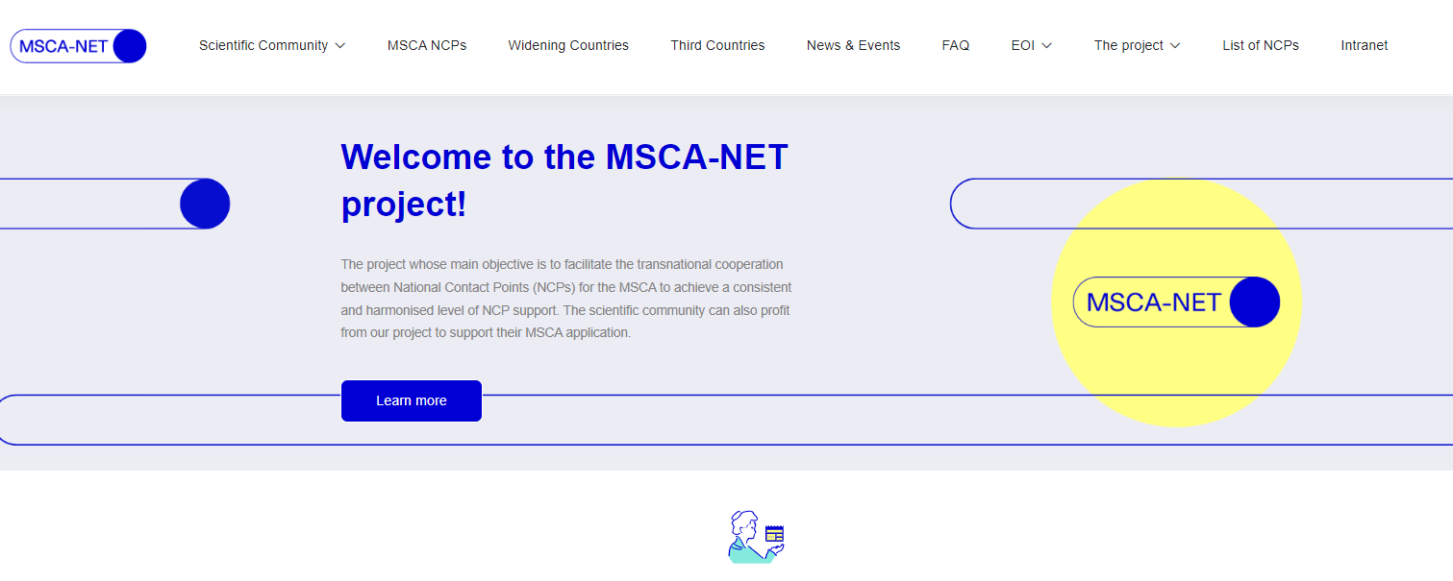

Slide 38


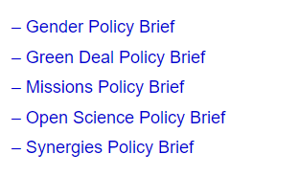

Slide 39
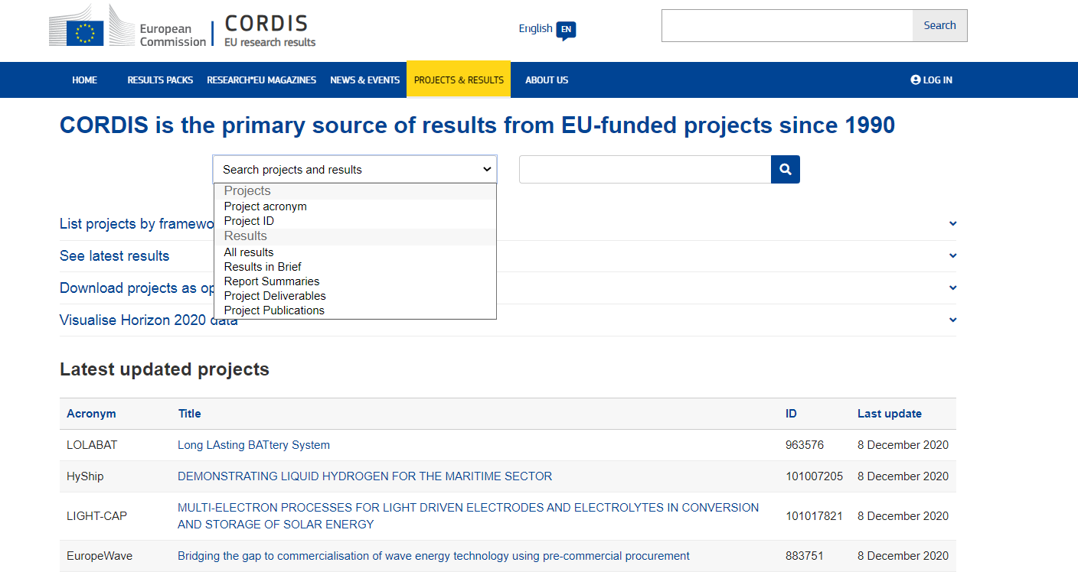

Slide 40
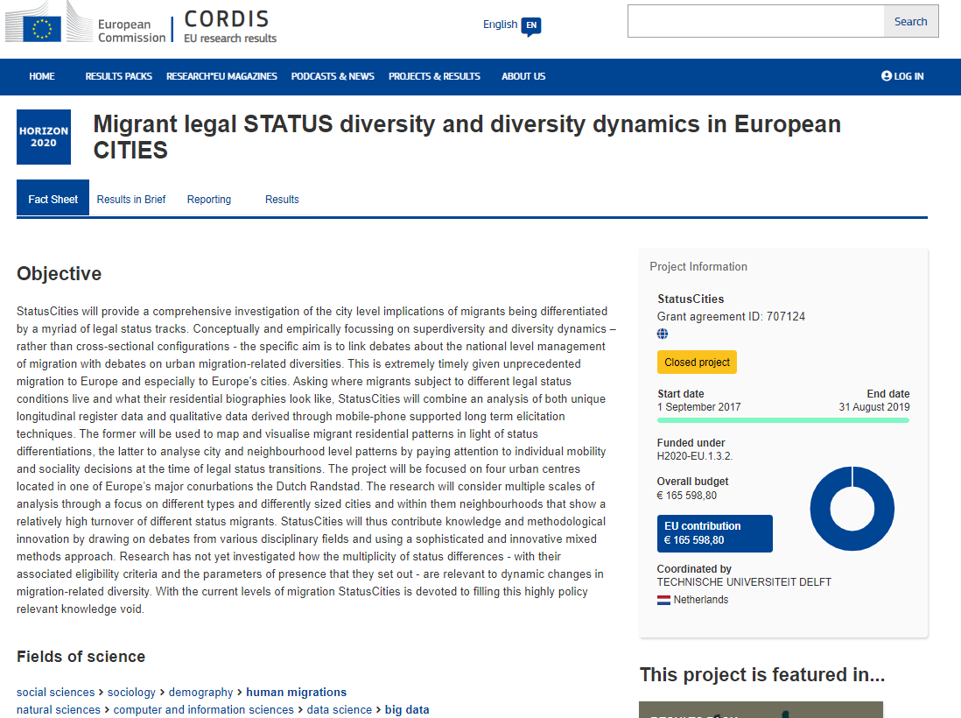

Slide 41

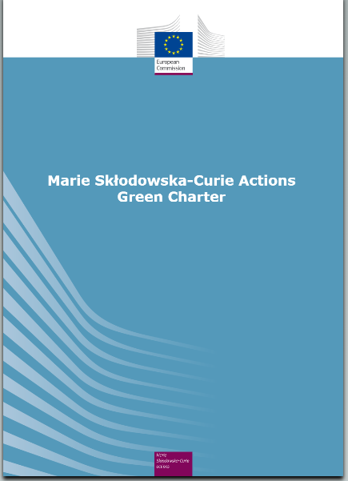
MSCA Green Charter
Horizon Europe Work Programme:
“All MSCA-funded projects are encouraged to address the principles of the MSCA Green Charter and implement measures to minimise the environmental footprint of their activities”.
https://ec.europa.eu/research/mariecurieactions/green-charter

Notes:
As you can read in the MSCA part of the Horizon Europe Work Programme, MSCA projects “are encouraged” to adhere the Green Charter, not obliged.
Even though it is not mandatory, we hope that the Charter will work as a soft tool to increase awareness and promote greener practices.
Over the years, we will look at the projects funded, to see whether or not they are implementing the Charter. If not, we might have to think about more binding measures in the future (e.g. green award criteria, green unit cost etc.).

Slide 42
EXCELLENCE POSTDOCTORAL FELLOWSHIPS

Slide 43
Excellence | Impact | Quality and efficiency of the implementation
Quality and pertinence of the project’s research and innovation objectives (and the extent to which they are ambitious, and go beyond the state of the art) | Credibility of the measures to enhance the career perspectives and employability of the researcher and contribution to his/her skills development | Quality and effectiveness of the work plan, assessment of risks and appropriateness of the effort assigned to work packages
Soundness of the proposed methodology (including interdisciplinary approaches, consideration of the gender dimension and other diversity aspects if relevant for the research project, and the quality of open science practices) | Suitability and quality of the measures to maximise expected outcomes and impacts, as set out in the dissemination and exploitation plan, including communication activities | Quality and capacity of the host institutions and participating organisations, including hosting arrangements
Quality of the supervision, training and of the two-way transfer of knowledge between the researcher and the host | The magnitude and importance of the project’s contribution to the expected scientific, societal and economic impacts
Quality and appropriateness of the researcher’s professional experience, competences and skills
50% | 30% | 20%

Slide 44

Excellence in a nutshell
the research conducted
R&I methodologies applied
individual fellows
collaborations fostered
knowledge transferred
training, supervision and career guidance provided

Slide 45
Excellence
Quality and pertinence of the project’s R&I objectives
Soundness of the proposed methodology
Quality of the supervision, training and of the two-way transfer of knowledge between the researcher and the host
Researcher’s professional experience, competences & skills
Introduction, specific R&I objectives and overview of the action – clear focused and up to point
Progress beyond the state of the art and ambition (focus on originality and innovative aspects – advancement within the action field)
Research methodology and overall approach – highlight the type of R&I activities
Interdisciplinary and intersectoral aspect of the action
Gender dimension and diversity in research content; Open science practices
Research data management and management of other research outputs
Qualifications and experience of the supervisor(s)
level of experience, track record, collaborations, projects, patents, supervision
How you will gain new knowledge – training through research and beyond (scientific and transferable skills)
concrete plan of training and realistic objectives (what, why, when..)
incl. new skills and knowledge via secondments
outcomes defined – developed competencies
How host will benefit from your presence – transfer of knowledge
Rationale and added-value of the non-academic placement (if applicable)
Demonstrate your accomplishments (research results, experience, projects, skills, knowledge, independent thinking, leadership, supervisions, management skills…
Describe your motivation, define career goals
How research will contribute to the career development plan

Slide 46
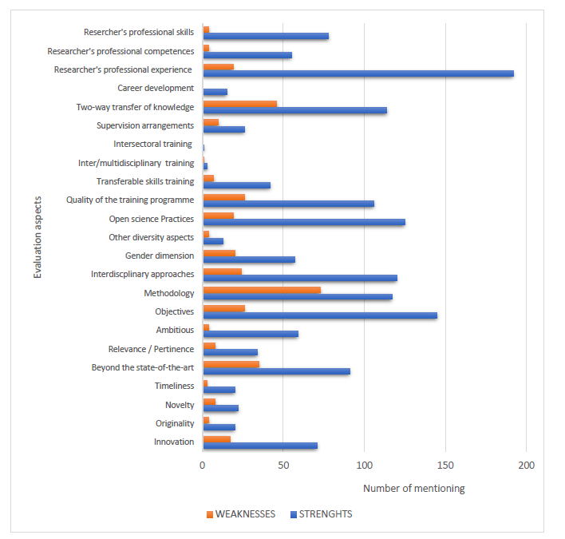
Excellence – strenghts and weaknesses of the European Fellowships
‘In the framework of the MSCA-NET network we have analysed the ESRs and herewith the outcomes are presented.’

Slide 47
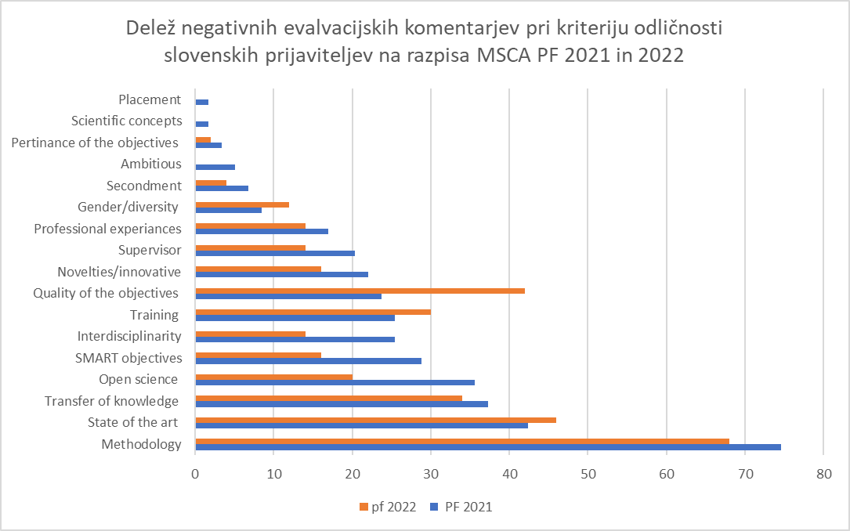

Slide 48
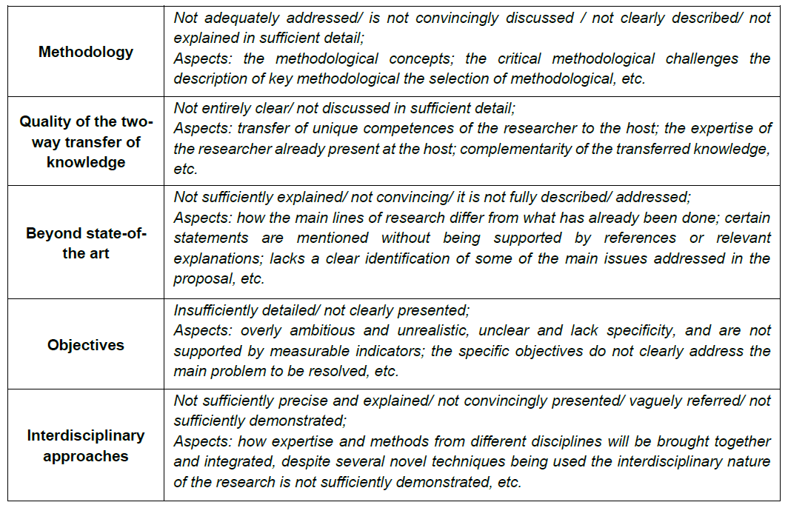
Reviewer feedback: top 5 weaknesses in Excellence

Slide 49
IMPACT Postdoctoral Fellowships

Slide 50
Excellence | Impact | Quality and efficiency of the implementation
Quality and pertinence of the project’s research and innovation objectives (and the extent to which they are ambitious, and go beyond the state of the art) | Credibility of the measures to enhance the career perspectives and employability of the researcher and contribution to his/her skills development | Quality and effectiveness of the work plan, assessment of risks and appropriateness of the effort assigned to work packages
Soundness of the proposed methodology (including interdisciplinary approaches, consideration of the gender dimension and other diversity aspects if relevant for the research project, and the quality of open science practices) | Suitability and quality of the measures to maximise expected outcomes and impacts, as set out in the dissemination and exploitation plan, including communication activities | Quality and capacity of the host institutions and participating organisations, including hosting arrangements
Quality of the supervision, training and of the two-way transfer of knowledge between the researcher and the host | The magnitude and importance of the project’s contribution to the expected scientific, societal and economic impacts
Quality and appropriateness of the researcher’s professional experience, competences and skills
50% | 30% | 20%

Slide 51
Impact section of your project - in a nutshell
impact on career
enhancement of the career of the postdoctoral fellow
dissemination, exploitation and communication activities
of the project and its results
impact on the wider scientific field, broader societal and economic implications
how will our knowledge be advanced by this project
how can it be relevant to the diverse stakeholder communities, policy-making, industry etc.
REMEMBER:
impact weights 30%
of your overall score

Slide 52
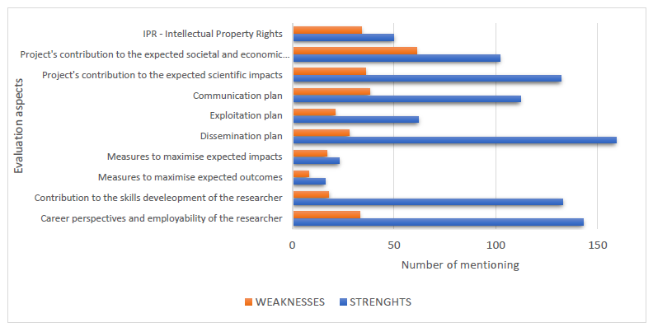
Impact – strenghts and weaknesses of the European Fellowships
‘In the framework of the MSCA-NET network we have analysed the ESRs and herewith the outcomes are presented.’

Slide 53
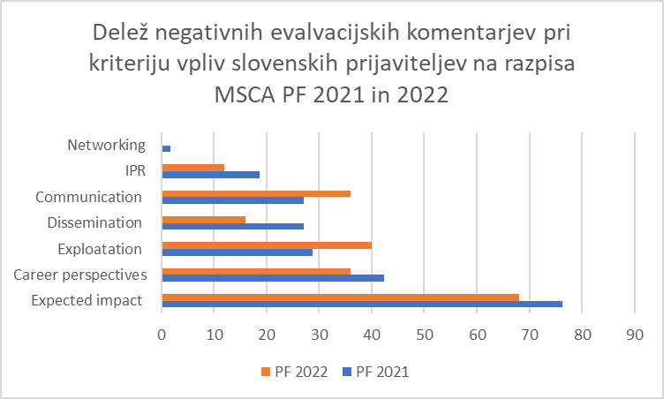

Slide 54
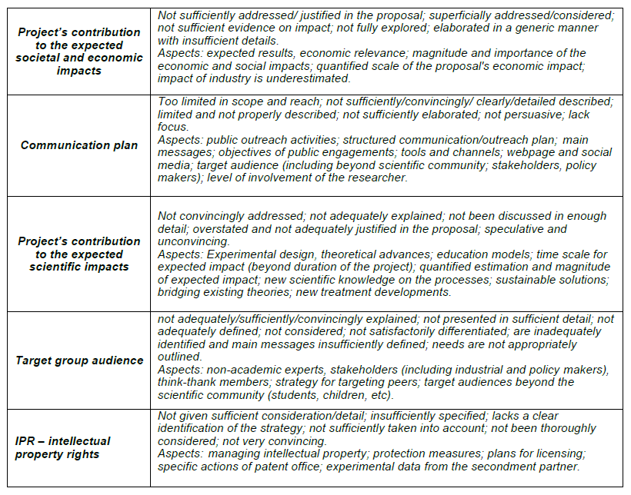
Reviewer feedback: top 5 weaknesses in Impact

Slide 55
IMPLEMENTATION POSTDOCTORAL FELLOWSHIPS

Slide 56
Excellence | Impact | Quality and efficiency of the implementation
Quality and pertinence of the project’s research and innovation objectives (and the extent to which they are ambitious, and go beyond the state of the art) | Credibility of the measures to enhance the career perspectives and employability of the researcher and contribution to his/her skills development | Quality and effectiveness of the work plan, assessment of risks and appropriateness of the effort assigned to work packages
Soundness of the proposed methodology (including interdisciplinary approaches, consideration of the gender dimension and other diversity aspects if relevant for the research project, and the quality of open science practices) | Suitability and quality of the measures to maximise expected outcomes and impacts, as set out in the dissemination and exploitation plan, including communication activities | Quality and capacity of the host institutions and participating organisations, including hosting arrangements
Quality of the supervision, training and of the two-way transfer of knowledge between the researcher and the host | The magnitude and importance of the project’s contribution to the expected scientific, societal and economic impacts
Quality and appropriateness of the researcher’s professional experience, competences and skills
50% | 30% | 20%

Slide 57
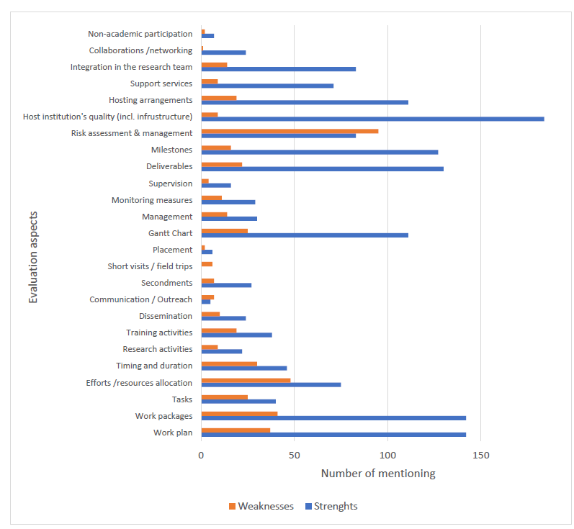
Implementation – strenghts and weaknesses of the European Fellowships
‘In the framework of the MSCA-NET network we have analysed the ESRs and herewith the outcomes are presented.’

Slide 58
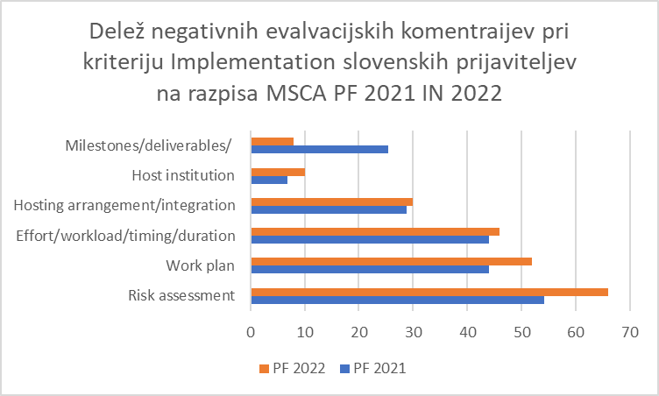

Slide 59
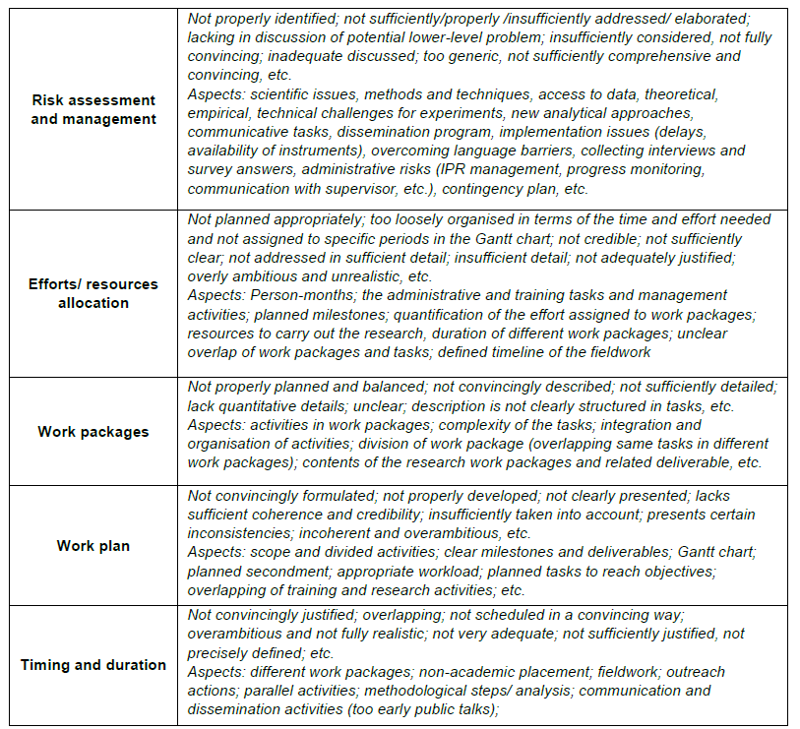
Reviewer feedback: top 5 weaknesses in Implementation

Slide 60
SOME General tips Postdoctoral Fellowships

Slide 61
How to succeed
Write more than a mere research project, think of it in terms of:
Opportunity to gain new knowledge by working on your own research project
- find a matching place and suitable supervisor(s)
Learning new skills for your future career:
additional scientific skills
transferable skills
Networking
- plan to expand your network for future collaborations
... scientific networking + public engagement
Communication & dissemination activities
- of research results in the scientific community
- raise awareness about your research among the general public
Mobility and knowledge transfer
- two-way knowledge transfer between researcher and host
- interdisciplinary and inter-sectoral knowledge

Slide 62
Practical tips
Start writing early enough - you will rewrite your proposal over and over
several months before the deadline
Ensure cooperation with the supervisor/host institution
you will need a lot of information
Make a checklist with all evaluation criteria
respond all of them dilligently
Use the call-specific Standard application form - available in the Submission System
Let others (non-experts as well) read your proposal
they must at least get a clue what your proposal is all about
test your proposal with different audiences – colleagues, collaborators, your future supervisor and perhaps some of his colleagues, project office at your host institute
See if you can get a proofreading help from MSCA NCP


Slide 63
Abstract
The abstract and keywords are used to select the evaluators.
It should sell your project and be understandable to the generalist
It should communicate the importance, impact and timeliness of the project and also convince the evaluator that you should be funded to carry it out.
It should NOT be the usual scientific abstract.
1-2 sentences that put your project into context
Your objective
Background information on the state of the art
Specific aims and details of your project plan
See ideas of existing projects in CORDIS
Max. 2 000 characters incl. spaces
Abstracts in part A should not contain sensitive information, as they will be made publicly available if the project is retained for funding

Slide 64

Common Errors
Proposal written as Scientific Paper – most usual for PF proposals
Objectives and “state-of-the-art” are elaborate and in-depth, but Implementation/ Methodology, “beyond-the-state-of-the-art” and Impact are under-developed
Unclear Aims and Objectives
Over-ambitious
Not enhancing training/ career
CV not properly presented or...not matching Part A...
Missing abstract, panel and keywords.
Off page limits... Template/ structure not followed
Essential parts disregarded (some sub-criteria not addressed)

Slide 65
Where to seek advice? National Contact Points (NCPs)
NCPs as national support structures for Horizon Europe applicants give personalised support on the spot and in applicants' own languages, in accordance with the NCP Guiding Principles agreed by all countries:
1. Guidance on choosing relevant Horizon Europe topics and types of action
2. Advice on administrative procedures and contractual issues
3. Training and assistance on proposal writing
4. Distribution of documentation (forms, guidelines, manuals etc.)
5. Assistance in partner search
Note: As the NCPs work in national structures, the type and level of services offered may differ from country to country.

Slide 66
PODPORA NKT za MSCA
Nacionalne/institucionalne/individualne informativne predstavitve razpisov
Delavnici za pripravo predlogov projektov
Individualni nasveti in pojasnila na vaša vprašanja
Tutorska pomoč uspešnih članov MSCA alumni kluba – seznam na spletni strani MVZI
Metodološki pred-pregled vaših predlogov projektov (pre-screening)
Najnovejše MSCA informacije na blogu

Slide 67
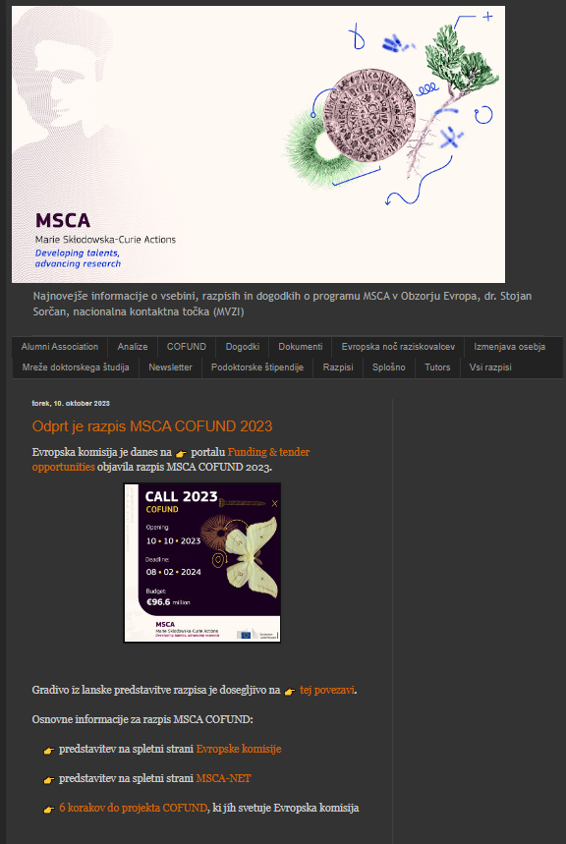
Najnovejše informacije za javnost, NCP MSCA v Obzorju Evropa (ncpmscaslovenija.blogspot.com)

Slide 68
Hvala lepa za vašo pozornost!
stojan.sorcan@gov.si
Najnovejše informacije za javnost, NCP MSCA v Obzorju Evropa (ncpmscaslovenija.blogspot.com)

